Slide 1
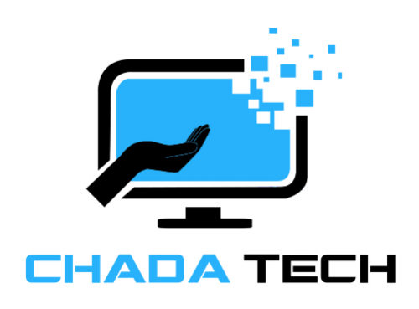
Agile Development

Slide 2
Contents
Chada Tech
APRIL 2026
01.
Explaining Agile Roles
02.
Explaining Agile Phases
03.
Describing Waterfall Method
04.
Waterfall or Agile Approach

Slide 3
Explaining Agile Roles
Product Owner
Scrum Master
Development
Chada Tech
APRIL 2026
Focuses on maximizing the value of product & work from the Development Team
Provides guidance in Agile Methodology
Liaison between Development team and Product Owner
Has Developers and Testers
Works collaboratively
Notes:
What is a Scrum Team? | Scrum.org. (n.d.). Www.scrum.org. https://www.scrum.org/resources/what-scrum-team
‌
‌

Slide 4
Explaining Agile Phases
Company Name
APRIL 2026
Planning
Analysis
Design
Coding
Testing
Deployment
Initial Project Plan
Detailed Documentation
Software Design Document
Functional Prototype
Refine and Optimize
Software in Production
Establishes what the goals are based on feedback from End Users & Stakeholders.
Project Managers and Development team fully understand and documented the scope of the project.
Discovering the projects architecture. A SDD is created so that developers have a roadmap when coding.
The Development team actually begins writing code and creating the product.
Testers conduct End User style testing so ensure the User Story’s have been executed. They also find bugs.
End Users access the new features.
Notes:
Jackson, G., Kosinski, M., & Holdsworth, J. (2024, December 13). What Is the Software Development Lifecycle (SDLC)? Ibm.com. https://www.ibm.com/think/topics/sdlc

Slide 5
Waterfall Method
Chada Tech
APRIL 2026
Requires contract negotiation and upfront scope of project
Does not allow for refinement or change of User stories
Is not flexible on timeline, does not have sprints
Better for simple projects that do not change
Notes:
Atlassian. (2025). Waterfall Methodology for Project Management. Atlassian. https://www.atlassian.com/agile/project-management/waterfall-methodology
‌

Slide 6
Agile vs Waterfall
Chada Tech
APRIL 2026
Agile
Waterfall
Flexibility
Flexibility
Constant room for refinement and change
Project is defined early and does not change
Which Approach?
Collaboration
Collaboration
Waterfall and Agile have their pros and cons. Check with the customers needs when deciding which methodology to use.
Team meets daily to discuss the project
Little to no meetings. One person per project
Timeline
Timeline
Good for long term projects that have changing deadlines
Good for quick projects that has a consistent deadline
Notes:
Kavlakoglu, E. (2024, July 25). Agile vs. Waterfall: What’s the Difference? | IBM. Www.ibm.com. https://www.ibm.com/think/topics/agile-vs-waterfall
‌

